Slide 1

Making the case for RDM services Amsterdam, January 25th 2017
Jonathan Rans
Digital Curation Centre
This work is licensed under the Creative Commons Attribution 2.5 UK: Scotland License.

Slide 2
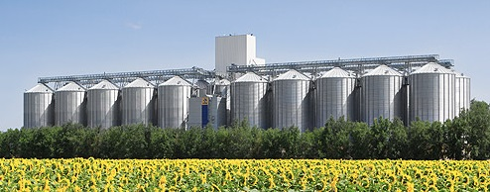
Some lessons from the IE programme
Some institutions still have fragile RDM programmes
Reliant on one or two individuals
No institutional memory
In some places services are beginning to be embedded but aren’t joined up.

Slide 3

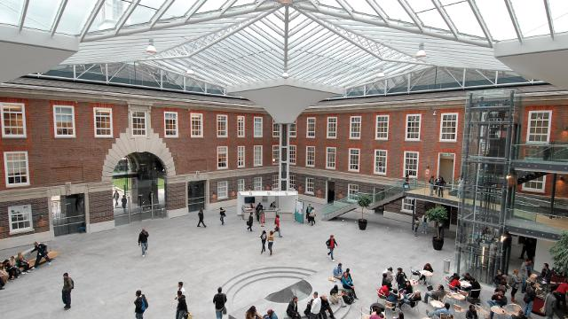
The size of institutions has an impact
Large, hierarchical institutions
Move slowly
Require a lot of advocacy
Have more resource
Economies of scale
Smaller institutions
More agile
Simpler communication
More focussed vision
Less resource

Slide 4
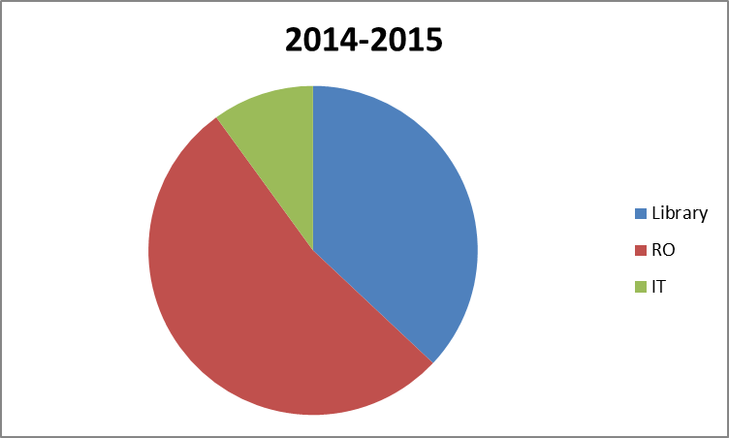
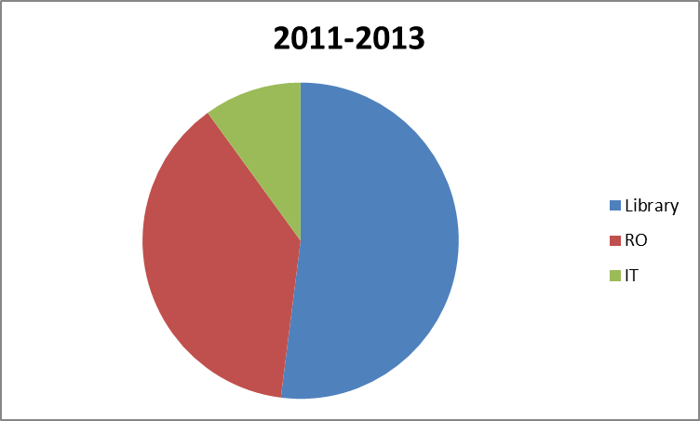
UK policy has had an impact
RDM project lead

Slide 5
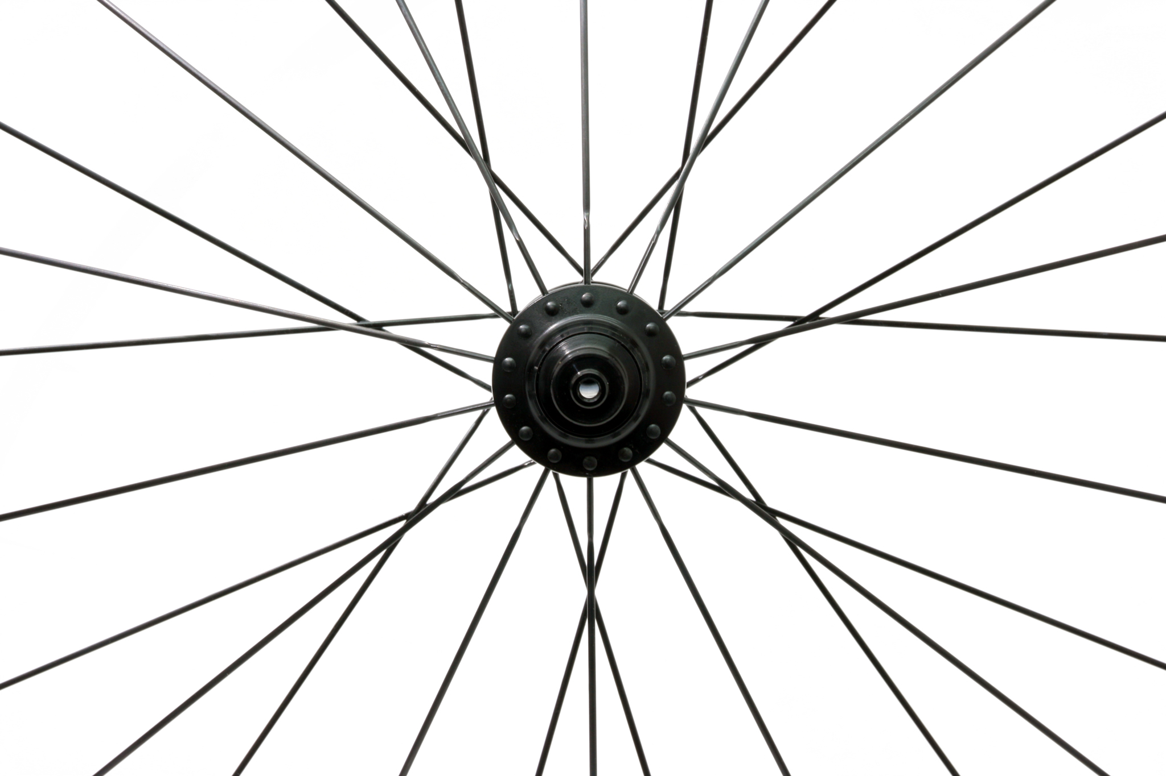
Identify key stakeholders

Slide 6
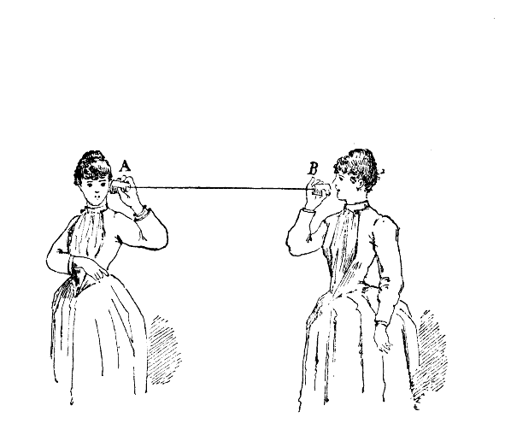
Channels and communication
Technical considerations
What systems need to integrate
How can choice of system promote engagement and information flow
Cultural considerations
Who needs to communicate
What structures/workflows need to be in place
Notes:
When we are talking about channels it helps to think both about what stakeholders or systems need to be connected and how systems can be designed to promote engagement with these channels.
Engaging researchers with new services
> Eg Repositories which often take time to populate
Communication between departments
> Eg the disconnect between library-based RDM services and RO DMP advice

Slide 7
Constructing the case
Identify the risks of doing nothing
Identify the benefits of providing support
To the institution
To the researchers
See Beagrie, N. and Pink, C.
http://opus.bath.ac.uk/32509/1/RDM_Benefits_vFinal.pdf
Definition of Service
“A means of delivering value to customers by facilitating outcomes customers want to achieve, but without the ownership of specific costs and risks.”
From ITIL service management approach
http://itsmtransition.com/2014/01/what-is-itil-service/

Slide 8
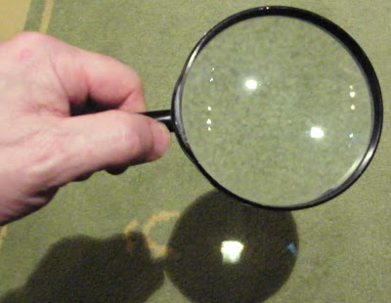
Quantify potential revenue loss
Performing a high-level financial analysis of research funding will identify the amount of funding which carries RDM conditions
As more funders publish requirements this exercise can help to prioritise areas for service development

Slide 9
Identify the needs of researchers
What policy and legislation must they comply with?
What problems are they struggling with that the service can help with
Can survey responses quantify this need?
Via lightweight surveys
Do you need more detailed information?
From DAF-style surveys
How can the value of research be enhanced?
in ways researchers perhaps haven’t thought of!

Slide 10

Gauging staffing levels needed
This can be very hard to judge
Support is often distributed
Examples from peers can help:
http://www.dcc.ac.uk/survey2015
The most research intensive institutions had 3.0FTEs assigned to RDM
Addressing individual service elements can be a useful approach

Slide 11
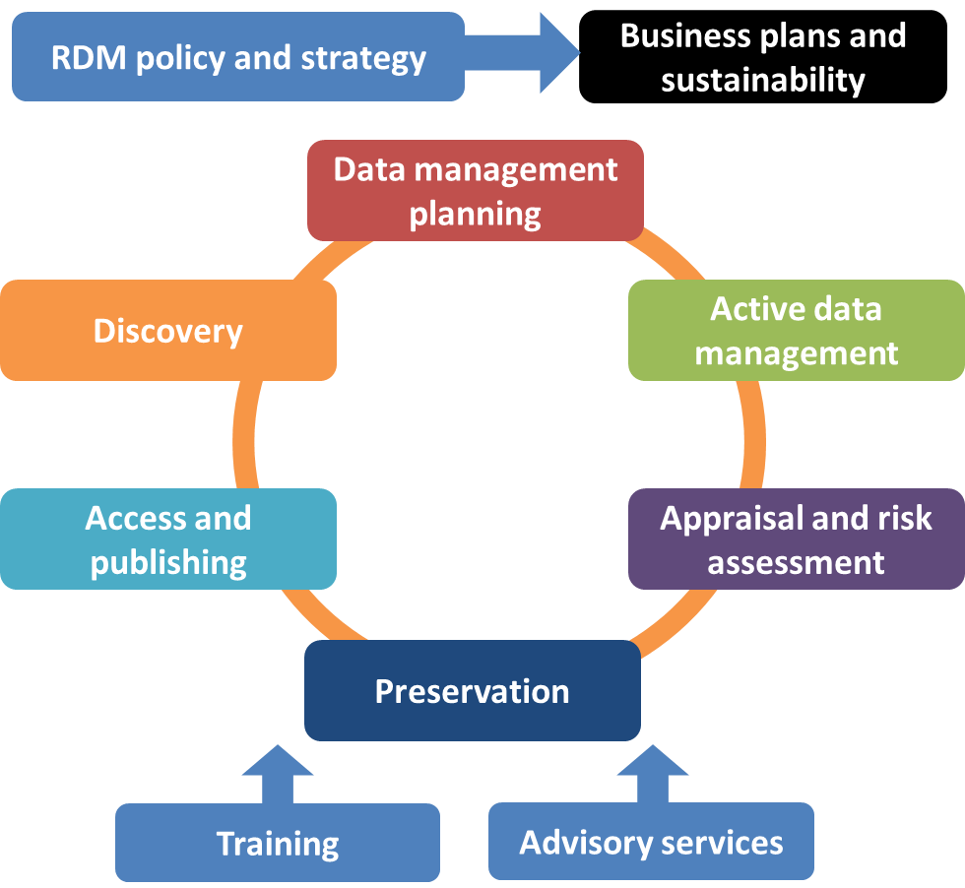
Breaking down the service

Slide 12
Capability models can help
Focus on what needs to be delivered and not how
Notes:
We are currently developing capability models as a framework for assessing RDM services and formulating a strategy for development. Our aim is to make these applicable both to institutions that are just starting out and to those that already have infrastructure components in place. For the latter this acts as a kind of healthcheck of current direction. These models enable us to focus on what capability you wish to deliver

Slide 13
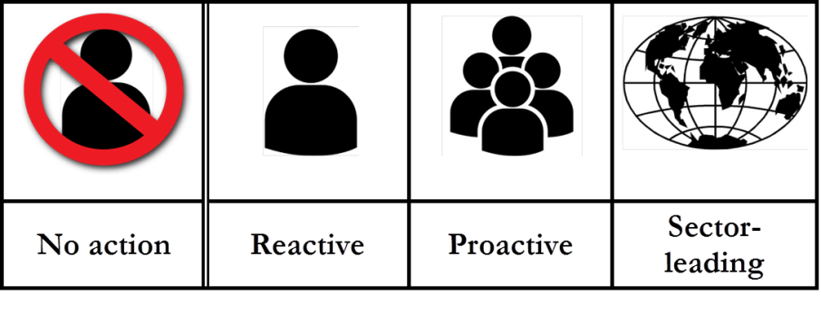
Address each element individually

Slide 14


Example: online training
Online training
Level One | Level Two | Level Three
Rebadged online courses are provided and linked to from RDM pages. | Rebadged online courses are supplemented with some in-house, locally produced materials. | A significant proportion of locally produced online courses are available. These are reused by others in the sector.
Notes:
An example of various capabilities delivered around online training materials:

Slide 15
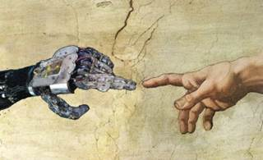
Take a holistic approach
There are challenges but also opportunities in implementation for improving connection between services.

Slide 16
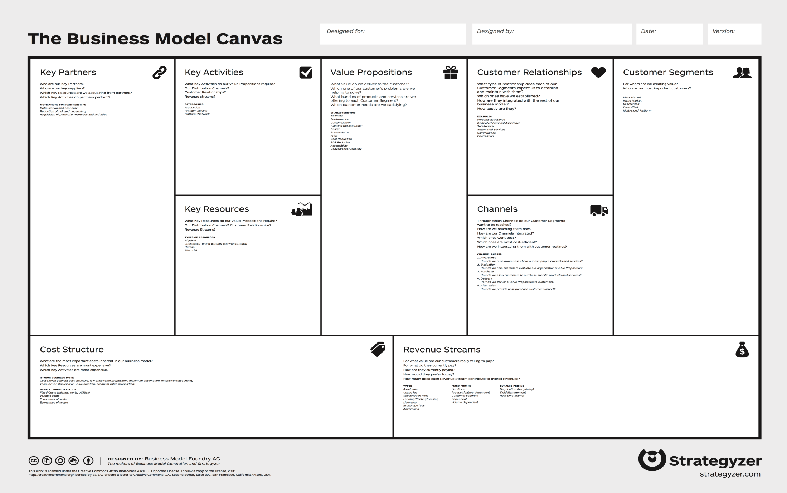
Business model canvas
Notes:
We will be introducing the business model canvas as a tool to help develop a business case for establishing RDM support components. It’s worth bearing in mind as you work through this tool what it is that you are aiming to achieve. It will be helpful to have a level of capability in mind as this will define what is an appropriate level of resource and will help to identify the benefits that the expenditure of resources will unlock.

Slide 17
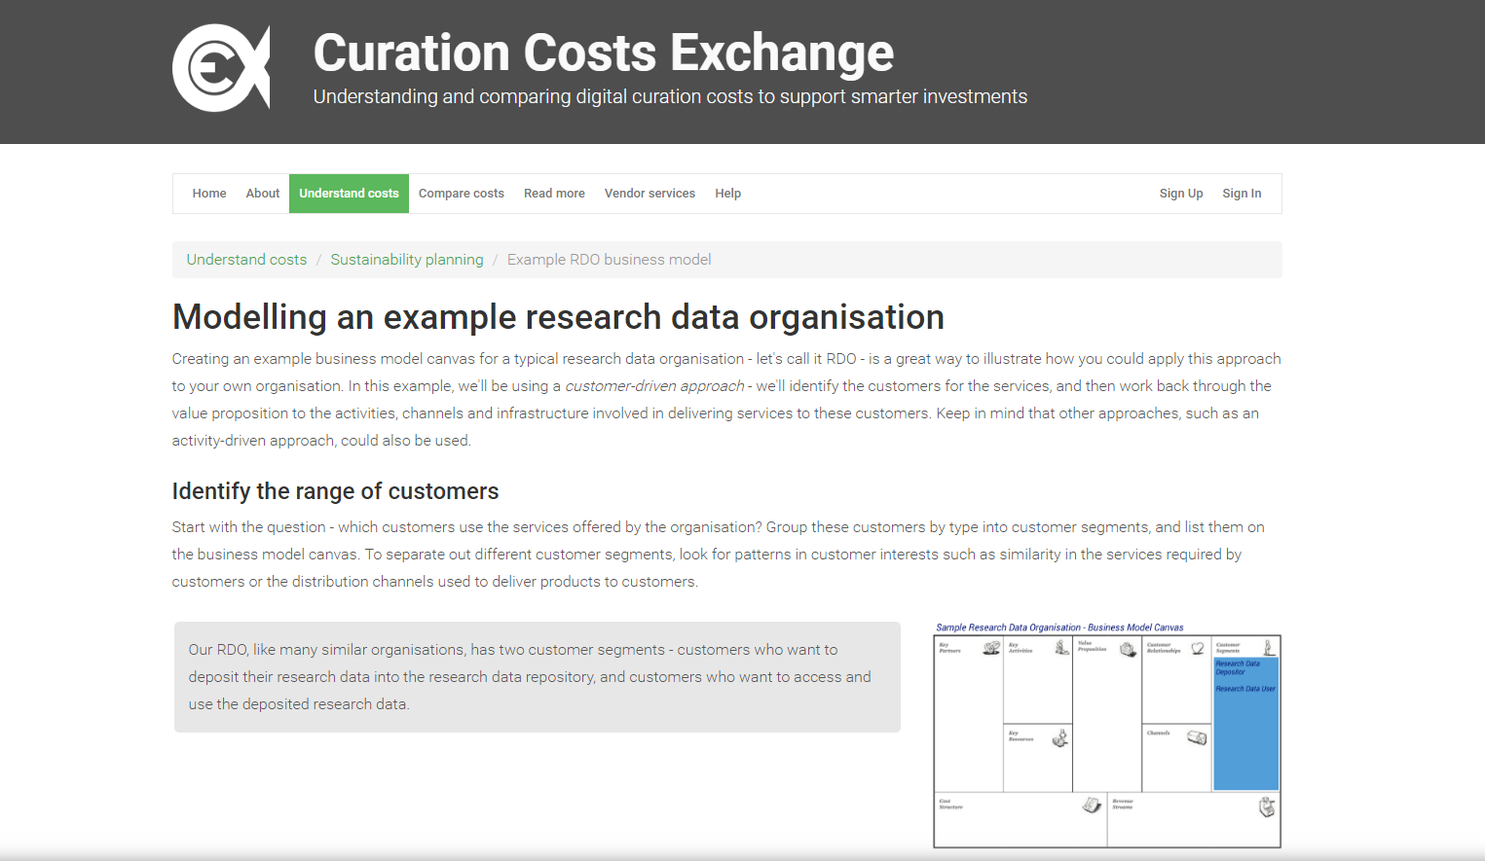
Applying the BMC to RDM
http://www.curationexchange.org/understand-your-costs/74-example-rdo-business-model

Slide 18

Case Study: The BMC at 4TU
4TU – A partnership of four universities in the Netherlands:
Eindhoven University of Technology
Technical University of Delft
University of Twente
University of Wageningen
Shared infrastructure across the federation
4TU.Centre for Research Data
Datalab
Services and Education

Slide 19

Outcomes of the BMC process
The BMC exercise aimed to define the services and their value
This informed business case, strategy and service marketing development
Well defined service values enable robust comparison with external services/providers
Notes:
Comparison is good for service users and providers – when considering moving services to external providers over in-house solutions

Slide 20

Thank-you, any questions?
Jonathan Rans
J.Rans@ed.ac.uk
@JNRans
Image Credits
Spokes – www.cdn.shopify.com
Magnifying glass – www.4.bp.blogspot.com
Sweets - https://www.textmarketer.co.uk
Silos – www.petkus.com
Robotic Michaelangelo – www.dmnews.com
4TU flyer - http://researchdata.4tu.nl/fileadmin/editor_upload/Flyer/Flyer_3TU.Datacentrum_2014.pdf

Slide 21
Group BMC exercise – value
Choose an RDM service element and:
Identify the customers who will interact with your service area.
Consider the reasons that your customers will use your service over possible alternatives. This may include not using a service at all. These represent the value proposition(s) for your RDM service.
Are there multiple stakeholders?
Will they each derive different value from the service?

Slide 22
DANS Business Model Canvas – 2014 and 2017

Slide 24
January 2017
availability of
& DataverseNL
Universities for applied sciences included
& WDS & DIN 31644
& Research Data Netherlands
& webinars
& information specialists
& consultancy

